Slide 1
Global Weather Analytics Dashboard
Under the Guidance of,
Shanmukha Priya
Springboard Mentor
Presented by:
Boddupalli Geethika

Slide 2
Project Objectives
Perform statistical analysis on global weather data
Identify seasonal patterns and long-term trends
Detect extreme weather events (heatwaves, heavy rainfall, strong winds)
Compare weather conditions across different regions and countries
Design and develop an interactive dashboard using Microsoft Power BI
Visualize complex data using charts and graphs for better understanding
Enable user interaction through filters and slicers
Provide meaningful insights for better decision-making

Slide 3
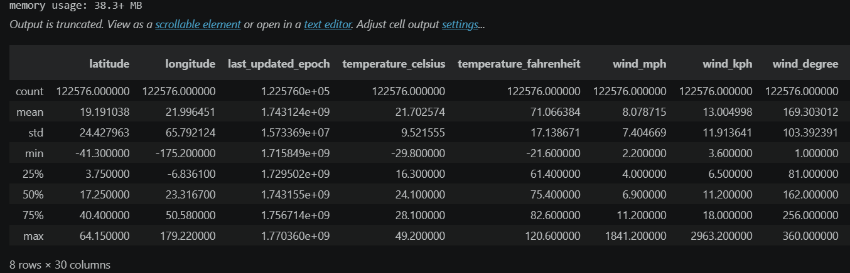
Perform Statistical Analysis on Global Weather Data
This objective focuses on analyzing the dataset using statistical methods to understand the overall behavior of weather parameters. Measures such as mean, maximum, minimum, and standard deviation are calculated for temperature, rainfall, wind speed, and other variables. This helps in understanding the distribution, variation, and general trends present in the data.

Slide 4
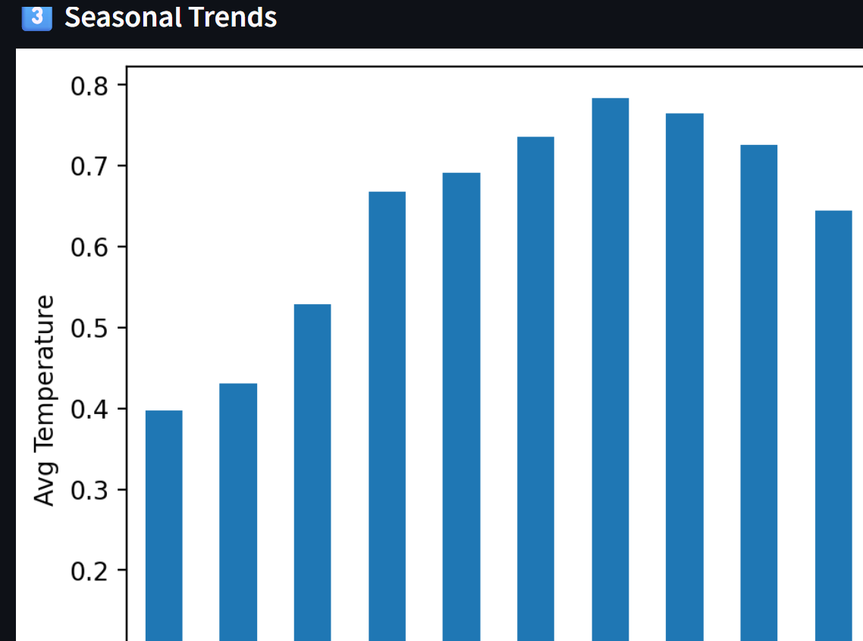
Identify Seasonal Patterns and Long-Term Trends
Weather conditions vary across different seasons and over time. This objective aims to analyze monthly and yearly data to identify recurring seasonal patterns, such as higher temperatures in summer or increased rainfall during monsoon periods. Long-term trend analysis helps in understanding whether temperature or rainfall is increasing or decreasing over time.

Slide 5

Detect Extreme Weather Events
This involves identifying unusual or extreme conditions in the dataset based on predefined thresholds. For example:
Temperature above 40°C → Heatwave
Rainfall above 100 mm → Heavy rainfall
Wind speed above 60 kph → Strong winds
Detecting such events helps in understanding climate risks and abnormal weather behavior.

Slide 6
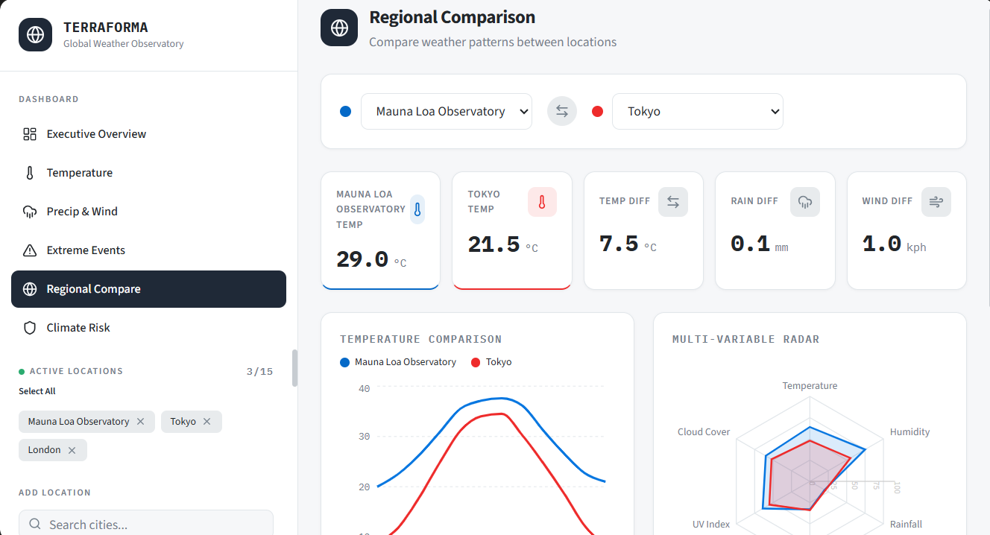
Compare Weather Conditions Across Different Regions and Countries
This objective focuses on comparing weather parameters between different countries or regions. By grouping and aggregating data, differences in temperature, rainfall, and wind speed can be analyzed. This comparison helps identify which regions are hotter, wetter, or more prone to extreme conditions.

Slide 7
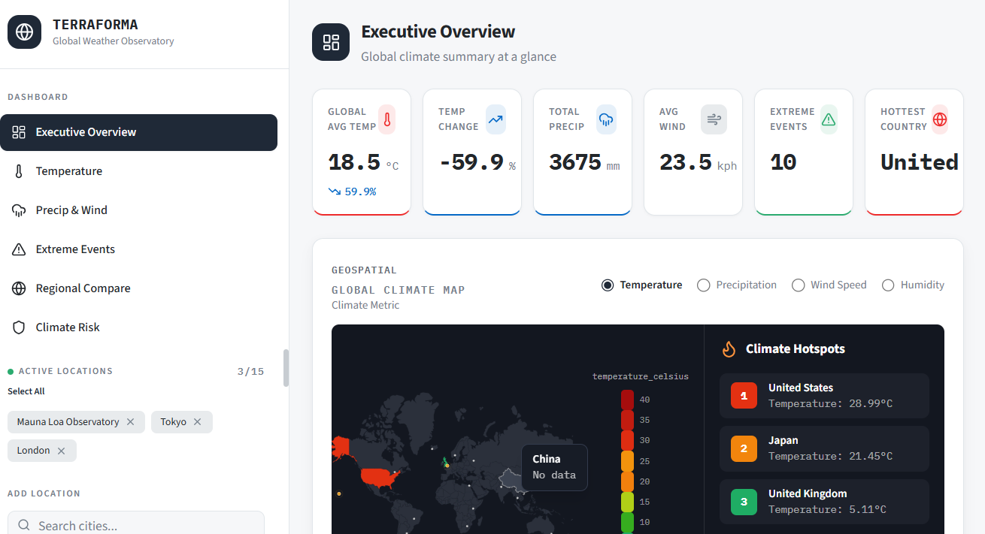
Design and Develop an Interactive Dashboard
The analyzed data is presented through an interactive dashboard. The dashboard is designed with multiple sections such as overview, temperature analysis, rainfall analysis, and extreme events. It provides a structured and visual representation of insights, making it easy for users to understand complex data.

Slide 8
Provide Meaningful Insights for Better Decision-Making
The final objective is to convert raw data into actionable insights. By analyzing and visualizing the data, users can understand climate patterns, detect risks, and make informed decisions. The dashboard serves as a tool for better interpretation and understanding of global weather conditions.

Slide 9
Conclusion
The Global Weather Analytics Dashboard project successfully demonstrates the application of data analytics and visualization techniques to analyze large-scale weather data and extract meaningful insights. The project was carried out in a structured manner through data preparation, analysis, and interactive dashboard development.
The development of an interactive dashboard using Microsoft Power BI enabled the transformation of complex data into visually intuitive charts and graphs. The inclusion of filters and slicers enhanced user interaction, allowing dynamic exploration and comparison of weather conditions across different regions and time periods.

Slide 10


